Slide 1
FEM updating optimization I/O plan
Implementing the SciTech paper’s optimization problem
Oct 2021

Slide 2
Start
Typical FEM updating process
Initial FEM
Modified FEM
Extract frequencies and mode shapes (at undeformed state)
Start
Check inertia properties, frequencies and mode shapes of the updated numerical model against the experimental data (Eq. 1)
GVT data: mode shapes, damping and frequencies (at undeformed state)
Termination criteria:
Maximum number of iterations exceeded
Acceptable match found within tolerance
NO
Convergence
YES
Updated FEM
End

Slide 3
Start
Modified FEM updating process for very flexible structures
Initial FEM
Modified FEM
Extract frequencies and mode shapes (at each of the n loading conditions)
Start
Initial n loading cases
Check inertia properties, frequencies and mode shapes of the updated numerical model against the experimental data (Eq. 2)
GVT data: mode shapes, damping and frequencies (at each of the n loading conditions)
GVT
Convergence
Exceed max iterations
NO
Increase number of loading cases (n)
Acceptable match found within tolerance
Updated FEM
End

Slide 4
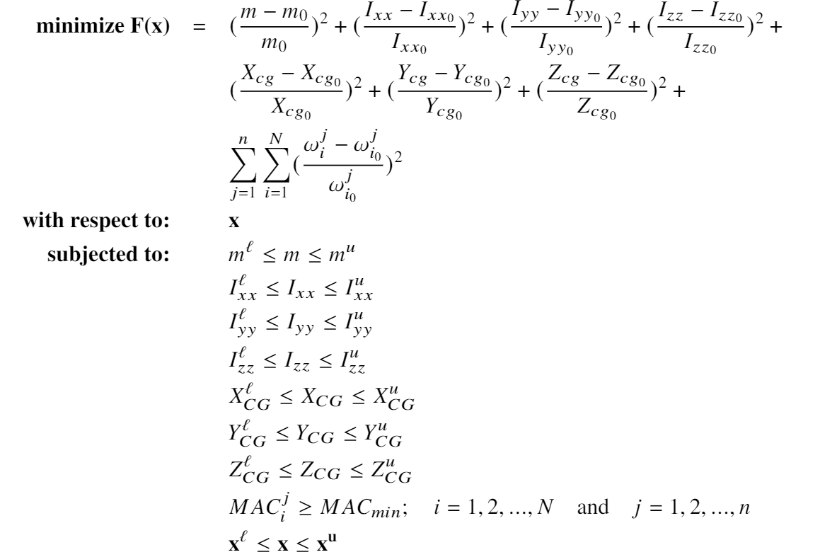
Optimization problem

Slide 5
Start
Mistuned Reference FEM
Initial FEM
Call Nastran SOL400 run with the Initial FEM for multiple load cases
Modified FEM
Verification of modified FEM updating process for very flexible structures
Extract results of the initial FEM – frequencies and mode shapes for multiple subcases
Extract frequencies and mode shapes (at each of the n loading conditions)
Call Nastran within the script and extract results for reference mode shapes and frequencies
Start
Initial n loading cases
Prepare inputs to the optimizer – SciPy or OpenMDAO
Check inertia properties, frequencies and mode shapes of the updated numerical model against the experimental data (Eq. 2)
GVT data: mode shapes, damping and frequencies (at each of the n loading conditions)
Reference FEM
Take the output of the optimizer and write a new input file for Nastran – each iteration gives a new Modified FEM – using pyNastran
Convergence
Exceed max iterations
NO
Increase number of loading cases (n)
Acceptable match found within tolerance
Updated FEM
End

